Slide 1

PIP2001 Capstone Project
Review-0
Birth/Death Registration Integration With Services
Batch Number:
Under the Supervision of,
Mr.Ramesh T
Professor / Associate Professor / Assistant Professor
School of Computer Science and Engineering
Presidency University
Roll Number | Student Name
20211CSE0289 | BHARGAVI S
20211CSE0745 | KIRAN KUMAR KC
20211CSE0629 | RAHUL GOWDA V
Name of the Program: CSE
Name of the HoD: Dr. Blessed Prince
Name of the Program Project Coordinator: Mr. Amarnath J.L & Dr. Jayanthi. K.
Name of the School Project Coordinators: Dr. Sampath A K / Dr. Abdul Khadar A / Mr. Md Ziaur Rahman

Slide 2
Content
Problem Statement
Github Link
Analysis of Problem Statement
Timeline of the Project
References

Slide 3
Problem Statement Number: PSCS135
Organization: CDK Global (India)Pvt Ltd
Category (Hardware / Software / Both) : Software
Problem Description:There are different services which are linked to Birth and Death of an individual. If these services are integrated together it will help individuals. Maternity Nursing home register’s child birth to Municipal Office Then Parent / guardian can one time enter the name of their child and get a print of Birth Certificate after few days. No need to visit MO. In case of Death registration at MO then build a system which will notify all tear down services to update death status of the individual.
Difficulty Level: Simple

Slide 4
Analysis of Problem Statement
Technology Stack Components:The project will utilize a combination of technologies, including web development frameworks, databases, and communication protocols.
Frontend (Web): HTML, CSS, JavaScript, Bootstrap
Frontend (Mobile): Android Studio
Backend: Node.js
Database: SQLite / MongoDB
APIs: RESTful APIs

Slide 5
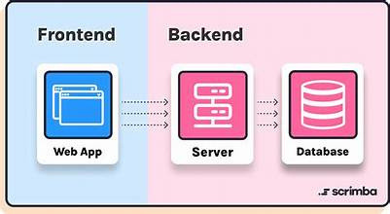
Analysis of Problem Statement (contd...)
Software Requirements:
Frontend: Mobile app for registration, status tracking, notifications, certificates
Backend: Manage submissions, integrate databases, handle notifications
Database: Store records and user data
APIs: RESTful for data handling

Slide 6
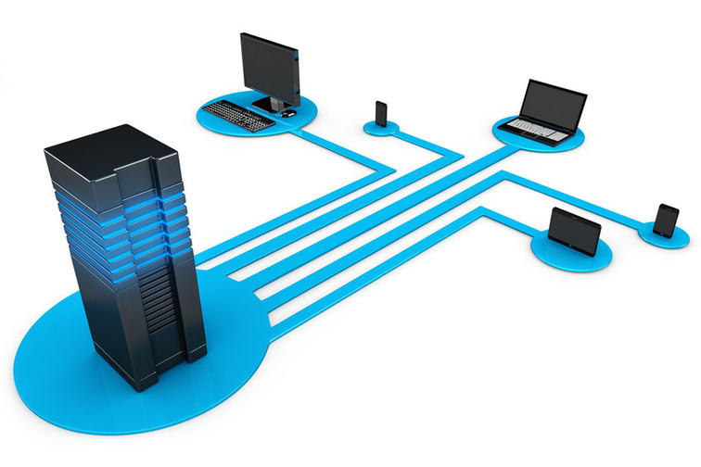
Analysis of Problem Statement (contd...)
Hardware Requirements:
Servers: For backend processing and data management
Network Infrastructure: For connectivity and communication
Devices: For user access and testing (e.g., mobile devices, computers)

Slide 7
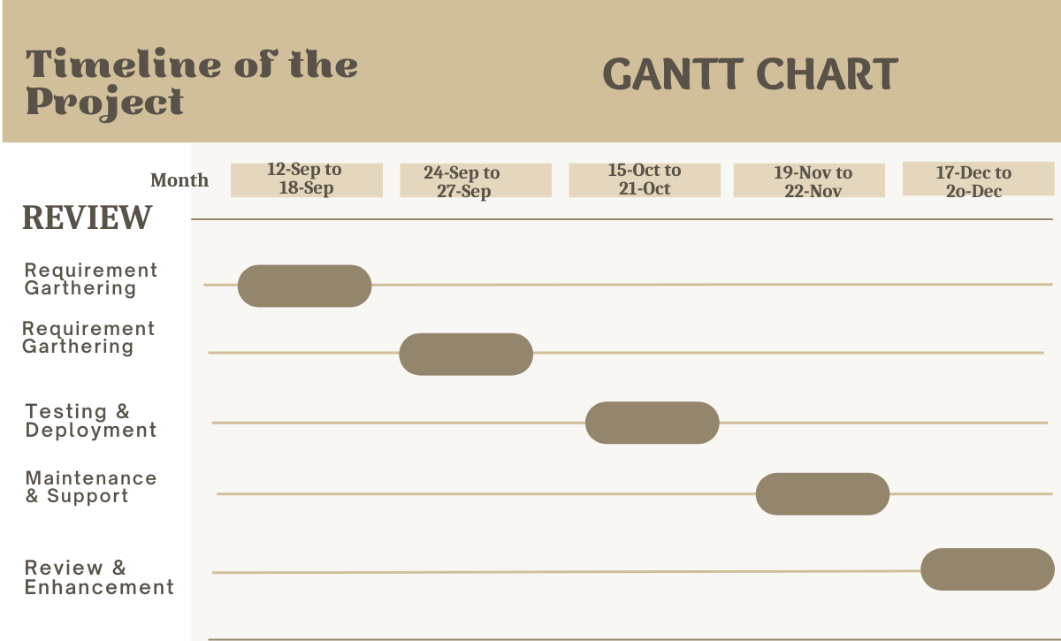
Timeline of the Project (Gantt Chart)

Slide 8


